Slide 1
HNDIT2301: Operating System and Information Security
Malicious Software
3. Program Security

Slide 2
Malicious software
Also known as malware
Any software that brings harm to a computer system.
Malware can be in number of forms
  Ex: worms, viruses, trojans, spyware, adware and rootkits…..,

Slide 3
Malicious Software Classification
Malicious Software
Host based
Trojan Horse
:Logic Bomb
Independent
Zombie
Trap Doors
Virus
Worm
Rabbit
Notes:
Stallings Fig 19-1.
Taxonomy can be divided into two categories: those that need a host program, and those that are independent;
can also differentiate between those software threats that do not replicate and those that do.

Slide 4
Trapdoors
Host based
secret entry point into a program
allows those who know access bypassing usual security procedures
have been commonly used by developers
a threat when left in production programs allowing exploited by attackers
very hard to block in O/S
requires good s/w development & update

Slide 5
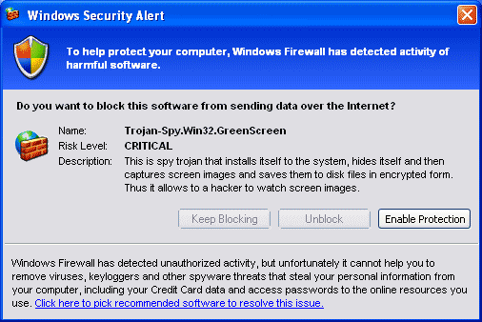
Trojan Horse
Host based
program with hidden side-effects which is usually superficially attractive
eg game, s/w upgrade etc
when run performs some additional tasks allows attacker to indirectly gain access they do not have directly often used to propagate a virus/worm or install a backdoor or simply to destroy data

Slide 6
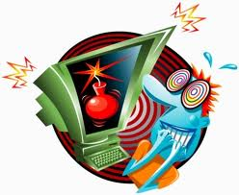
Logic Bomb
Host based
one of oldest types of malicious software
code embedded in legitimate program
activated when specified conditions met
  eg presence/absence of some file
  particular date/time
  particular user
when triggered typically damage system
  modify/delete files/disks

Slide 7
Viruses
Host based
a piece of self-replicating code attached to some other code
  cf biological virus
both propagates itself & carries a payload
  carries code to make copies of itself
  as well as code to perform some covert task

Slide 8
Rabbit
Independent
Term used to describe malware that multiplies rapidly – also called bacteria
two kinds of rabbits
  program which tries to consume all of some system resource, like disk space
  standalone program which replicates itself across a network from machine to machine, but deletes the original copy of itself after replication.

Slide 9
Zombie
Independent
program which secretly takes over another networked computer
then uses it to indirectly launch attacks
often used to launch distributed denial of service (DDoS) attacks
exploits known flaws in network systems

Slide 10
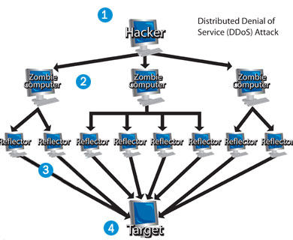

Slide 11
DDoS Countermeasures
three broad lines of defense:
  attack prevention & preemption (before)
  attack detection & filtering (during)
  attack source traceback & ident (after)
huge range of attack possibilities
hence evolving countermeasures

Slide 12
Worms
Independent
replicating but not infecting program
typically spreads over a network
  cf Morris Internet Worm in 1988
  led to creation of CERTs
using users distributed privileges or by exploiting system vulnerabilities
widely used by hackers to create zombie PC's, subsequently used for further attacks, esp DoS
major issue is lack of security of permanently connected systems, esp PC's

Slide 13
Worm Operation
worm phases like those of viruses:
  dormant
  propagation
    search for other systems to infect
    establish connection to target remote system
    replicate self onto remote system
  triggering
  execution

Slide 14
Morris Worm
best known classic worm
released by Robert Morris in 1988
targeted Unix systems
using several propagation techniques
  simple password cracking of local pw file
  exploit bug in finger daemon
  exploit debug trapdoor in sendmail daemon
if any attack succeeds then replicated self

Slide 15
Recent Worm Attacks
new spate of attacks from mid-2001
Code Red
  exploited bug in MS IIS to penetrate & spread
  probes random IPs for systems running IIS
  had trigger time for denial-of-service attack
  2nd wave infected 360000 servers in 14 hours
Code Red 2
  had backdoor installed to allow remote control
Nimda
  used multiple infection mechanisms
    email, shares, web client, IIS, Code Red 2 backdoor

Slide 16
Spyware
Software which collects information from a computer without owners knowledge and transmits it to someone unauthorised to use them.
Information may include:
  User names and Passwords
  E mail addresses
  Bank account of credit card numbers
  Software license keys

Slide 17
Adware
more marketing-focused, and may pop up
advertisements or redirect a user's web browser to certain web sites in the hopes
of making a sale.
Some attempt to target the advertisement to fit context of what user is doing
  Ex. a search for "Calgary" may
  result in an unsolicited pop-up advertisement for "books about Calgary.“

Slide 18
Virus Operation
virus phases:
  dormant – waiting on trigger event
  propagation – replicating to programs/disks
  triggering – by event to execute payload
  execution – of payload
details usually machine/OS specific
  exploiting features/weaknesses

Slide 19
Virus Structure
program V :=
{goto main;
1234567;
subroutine infect-executable := {loop:
file := get-random-executable-file;
if (first-line-of-file = 1234567) then goto loop
else prepend V to file; }
subroutine do-damage := {whatever damage is to be done}
subroutine trigger-pulled := {return true if some condition holds}
main: main-program := {infect-executable;
if trigger-pulled then do-damage;
goto next;}
next:
}
Notes:
Stallings Fig 19-2.

Slide 20
Types of Viruses
can classify on basis of how they attack
  parasitic virus
  memory-resident virus
  boot sector virus
  stealth
  polymorphic virus
  macro virus

Slide 21
Macro Virus
macro code attached to some data file
interpreted by program using file
  eg Word/Excel macros
  esp. using auto command & command macros
code is now platform independent
is a major source of new viral infections
blurs distinction between data and program files making task of detection much harder
classic trade-off: "ease of use" vs "security"

Slide 22
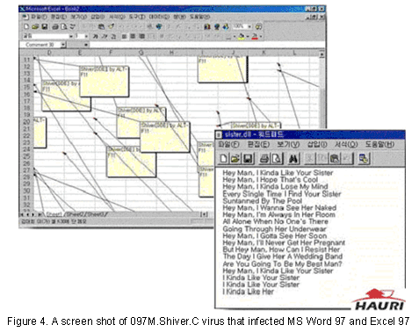
Macro Virus

Slide 23
Email Virus
spread using email with attachment containing a macro virus
  cf Melissa
triggered when user opens attachment
or worse even when mail viewed by using scripting features in mail agent
usually targeted at Microsoft Outlook mail agent & Word/Excel documents

Slide 24
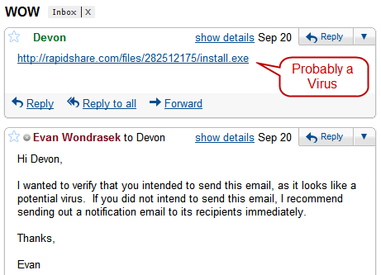
E mail Virus

Slide 25
Virus Countermeasures
viral attacks exploit lack of integrity control on systems
to defend need to add such controls
typically by one or more of:
  prevention - block virus infection mechanism
  detection - of viruses in infected system
  reaction - restoring system to clean state

Slide 26
Anti-Virus Software
first-generation
  scanner uses virus signature to identify virus
  or change in length of programs
second-generation
  uses heuristic rules to spot viral infection
  or uses program checksums to spot changes
third-generation
  memory-resident programs identify virus by actions
fourth-generation
  packages with a variety of antivirus techniques
  eg scanning & activity traps, access-controls

Slide 27
Advanced Anti-Virus Techniques
generic decryption
  use CPU simulator to check program signature & behavior before actually running it
digital immune system (IBM)
  general purpose emulation & virus detection
  any virus entering org is captured, analyzed, detection/shielding created for it, removed

Slide 28
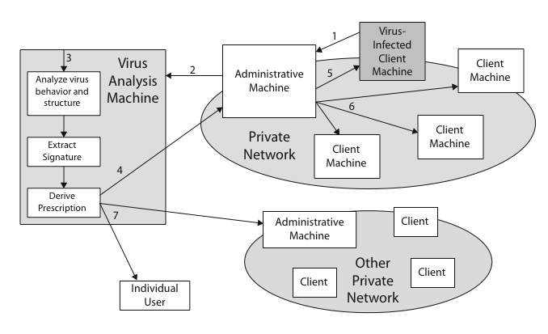
Digital Immune System

Slide 29
Behavior-Blocking Software
integrated with host O/S
monitors program behavior in real-time
  eg file access, disk format, executable mods, system settings changes, network access
for possibly malicious actions
  if detected can block, terminate, or seek ok
has advantage over scanners
but malicious code runs before detection

